Slide 1
Note for the teachers not for the students
Dear colleagues,
I like to request you to read the instructions below the pages to conduct the class spontaneously. If you think any change, you can do it according to your thinking. After all “Teacher himself is the best method.”
Thanking you
Md. Hasan Hafizur Rahman
Cambrian School & College
Dhaka, Cell : 01717220115

Slide 2
Good Morning
Notes:
Welcome slide. Teacher may change it according to his will.

Slide 3
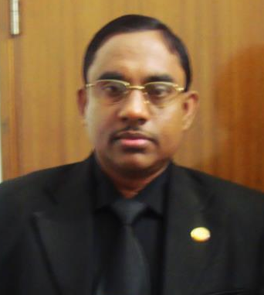
Identity
Lecturer & Head of the Department (English)
Cambrian School & College
Bulding-5, Baridhara, Dhaka
English For Today
Class IX-X
Md.Hasan Hafizur Rahman
Notes:
Identity of teacher & class

Slide 4
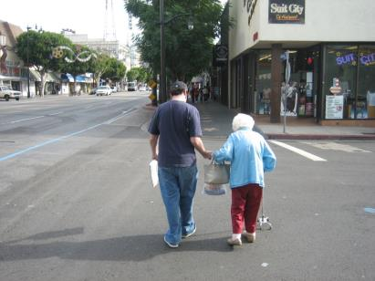
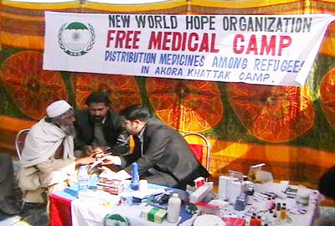
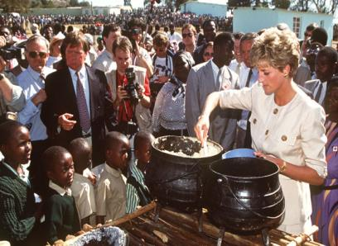
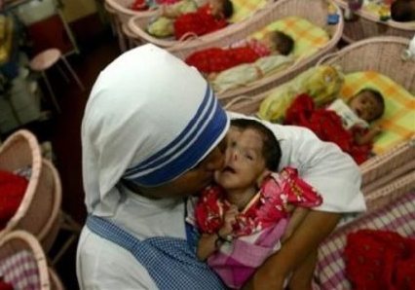
Love for humanity
Notes:
Teacher will ask about the picture to take out the lesson declaration from the students.

Slide 5
Our today’s lesson is-
Love for humanity
Unit-7, Lesson-6
Notes:
Lesson declaration

Slide 6
Learning outcomes
After studied this lesson, students will be able to---
ask and answer question
read and understand through silent reading
Notes:
Listening, speaking & reading skills will be focused in this lesson.

Slide 7
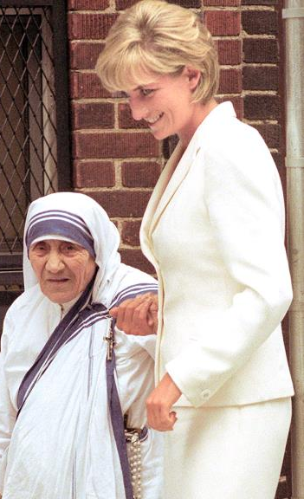
Do you know them?
Mother Teresa
Princess
Diana
Notes:
To advance to Mother Teresa.

Slide 8
What sign did she leave for humanity?
Missionaries of Charity
Notes:
Just to make the idea about Missionaries of Charity, thi svideo shown.

Slide 9
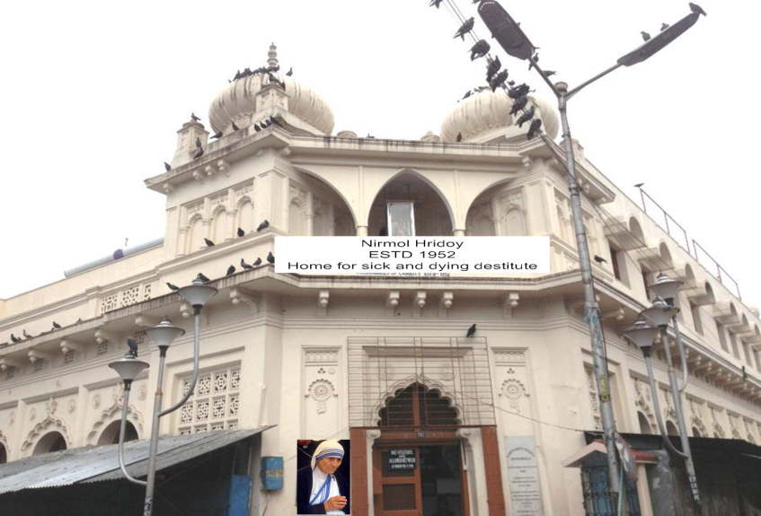
Mother Teresa founded this institute for the sick and dying people on the streets of Kolkata.
Notes:
Contribution of Mother Teresa.

Slide 10
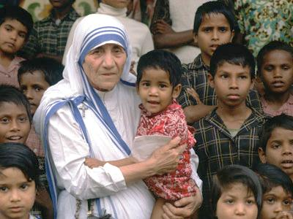
A Look at the picture and talk about it in pairs.

Slide 11
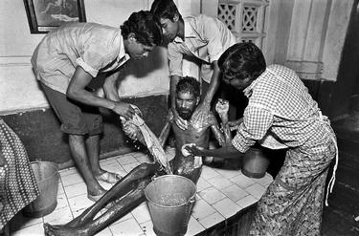
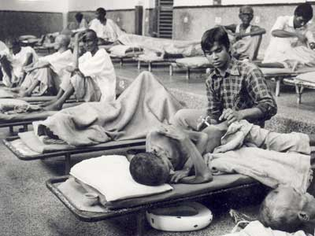
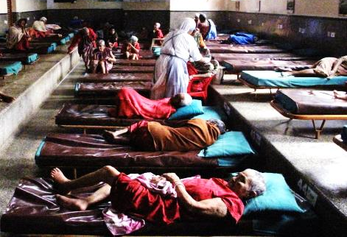
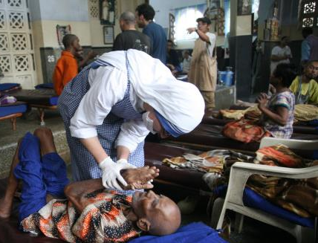
She and her fellow nuns gathered the dying people off the streets of Kolkata and brought them to this home. They were lovingly looked after and cared for.

Slide 12
What would happen then? Let’s see from the text
Dear students,
Open you text book at page 95 and start reading from “Since then men, women and children ------------Mother Teresa in our mind” silently. I will help you.
Notes:
To relate the text, teacher may conduct this session through silent reading. Teacher may move to the class to help the learners reading the text.

Slide 13
Since then men, women and children have been taken from the streets and carried to Nirmol Hridoy. T hese unloved and uncared for people get an opportunity to die in an environment of kindness and love. In their last hours they get human and Divine love, and can feel they are also children of God. Those who survive, the Missionaries of Charity try to find jobs for them or send them to homes where they can live happily for some more years in a caring environment. Regarding commitment to family, Mother Teresa said, “ Maybe in our own family, we have somebody, who is feeling lonely, who is feeling sick, who is feeling worried. Are we there? Are we willing to give until it hurts in order to be with our families, or do we put our interest first? We must remember that love begins at home and we must also remember that future of humanity passes through the family”.
Notes:
This slide may used in any purpose if the teacher feels necessity. Suppose, there are some students who have no text books with them, teacher may provide it for silent reading.

Slide 14
Let’s have a look at the golden achievements of Mother Teresa.
Notes:
Some of the achievements of Mother Teresa shown to provide a clear massage about her.

Slide 15
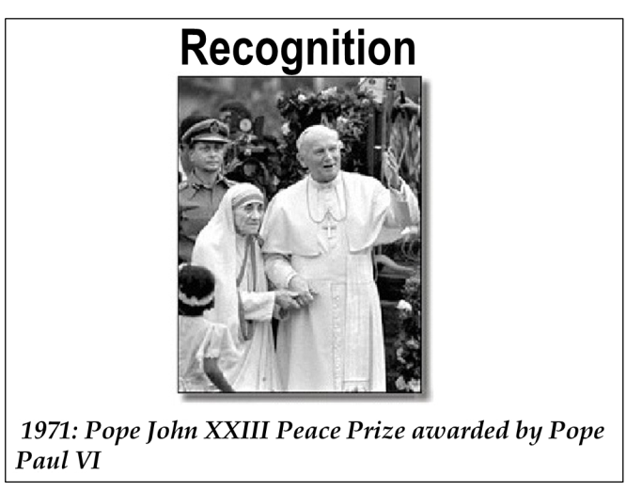
Mother Teresa's work has been recognised throughout the world and she has received a number of awards.
Pope John XXIII Peace Prize 1971
Notes:
Mother Teresa was first awarded.

Slide 16
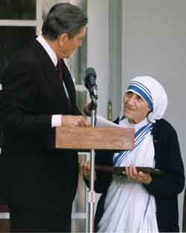
The Nehru Prize for Promotion of International Peace & Understanding 1972
Notes:
Another schievement.

Slide 17
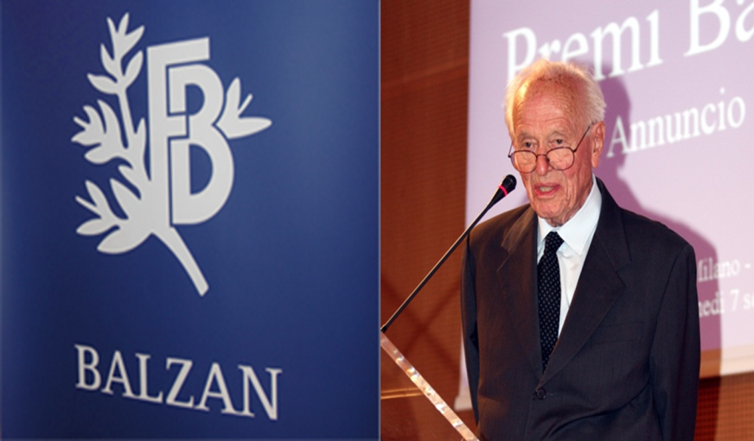
The Balzan Prize 1978
Notes:
One more achievement.

Slide 18
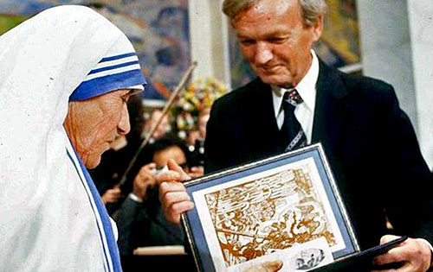
The Nobel Peace Prize 1979
Notes:
Nobel prize.

Slide 19
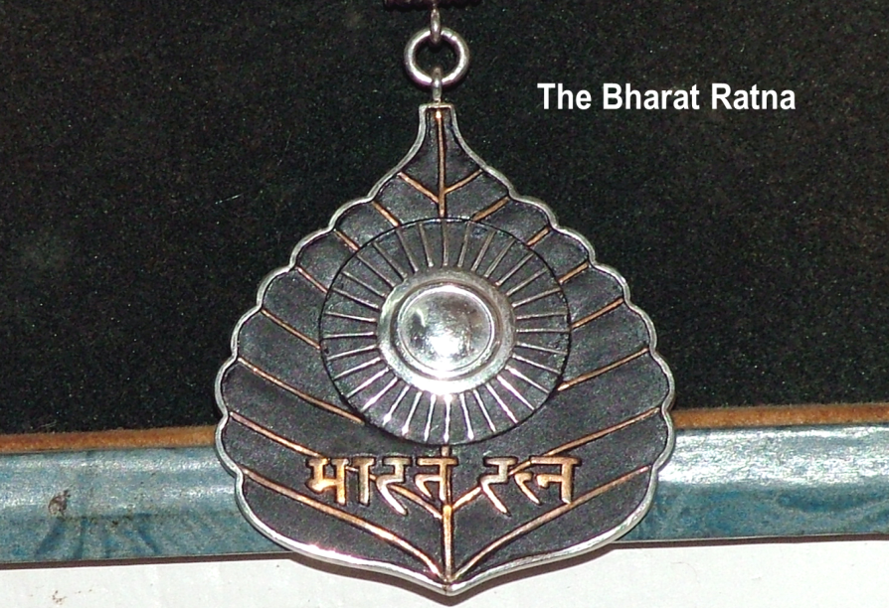
and the Bharat Ratna 1980
Notes:
Prize from India.

Slide 20
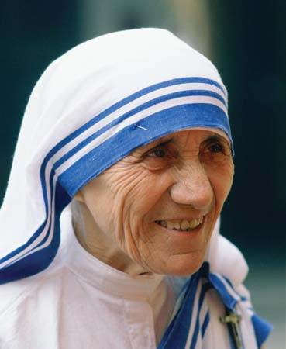
Let us see Mother Teresa’s facial appearance.
Draped in a white and blue-bordered sari
Ever soft eyes
Saintly smile
wrinkled face
This holly soul breathed her last on 5 September 1997 at the age of 87.
Notes:
Text information.

Slide 21
C Now say whether the following statements are true or false. If false, give the correct information.
1 Mother Teresa was moved to see the diseases that spread in the streets of Kolkata.
2 She opened a home for the orphans.
3 She and her group brought in the dying people from the streets of Kolkata.
4 ‘Nirmol Hridoy’ was founded so that the poor people who are dying can get love and care before death.
5 Mother Teresa said that humanity passes through charitable organization.
6 We have learnt how to come forward to help only those who belong to a special caste.
Notes:
Evaluation chapter.

Slide 22
D Read the text in B again and write the answer to the following questions in your exercise book.
1 Why do you think Mother Teresa won so many awards?
2 What does ‘Nirmol Hridoy’ stand for?
3 Why do you think the home is named ‘Nirmol Hridoy’?
4 Why did Mother Teresa want the dying people to feel that they deserve care and love too?
5 What are things that we have learnt from Mother Teresa?
Notes:
Teacher may conduct this session with the help of the text book.

Slide 23
See you again
Notes:
Last greeting.

